Slide 1

Exploring perth house prices
Predicting Property values

Slide 3
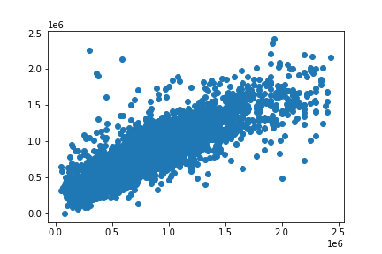
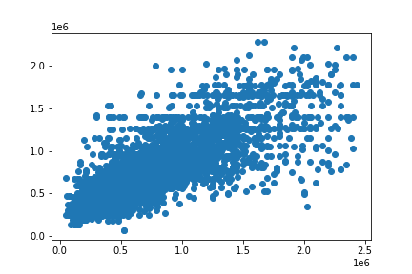
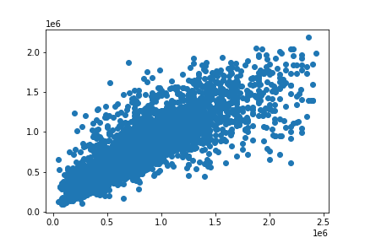
The Linear Regression Model Shows
Linear regression model
DECISION TREE MODEL
Random forest model

